Slide 1

By: Mohit Goel
Assistant Professor
Email id- mohit.16907@lpu.co.in
Block-36, Room No.-203

Slide 2
Task Domains of Artificial Intelligence/ Applications of AI
Mundane Tasks
Perception
Vision
Speech
Natural language
Understanding
Generation
Translation
Common sense reasoning
Robot control

Slide 3
Task Domains of Artificial Intelligence/ Applications of AI
Expert Tasks
Engineering
Design
Fault finding
Manufacturing planning
Scientific analysis
Medical diagnosis
Financial analysis

Slide 4
Task Domains of Artificial Intelligence/ Applications of AI
Formal Tasks
Games
Chess
Backgammon
Checkers –Go
Mathematics
Geometry
Logic
Integral calculus
Proving properties of programs

Slide 5
AI Problem
Before embarking on a study of specific AI problems and solution techniques, it is important at least to discuss, if not to answer, the following four questions:
What are our underlying assumptions about intelligence?
What kinds of techniques will be useful for solving Al problems?
At what level of detail, if at all, are we trying to model human intelligence?
How will we know when we have succeeded in building an intelligent program?

Slide 6
Knowledge:
One of the few hard and fast results to come out of the first three decades of AI research is that intelligence requires knowledge. To compensate for its one overpowering asset, indispensability, knowledge possesses some less desirable properties, including:
It is voluminous.
It is hard to characterize accurately.
It is constantly changing.
It differs from data by being organized in a way that corresponds to the ways it will be used.

Slide 7
An AI technique is a method that exploits knowledge
that is represented so that:
The knowledge captures generalizations that share properties, are grouped together, rather than being allowed separate representation.
It can be understood by people who must provide it—even though for many programs bulk of the data comes automatically from readings.
In many AI domains, how the people understand the same people must supply the knowledge to a program.
It can be easily modified to correct errors and reflect changes in real conditions.
It can be widely used even if it is incomplete or inaccurate.
It can be used to help overcome its own sheer bulk by helping to narrow the range of possibilities that must be usually considered.

Slide 9
Tic-Tac-Toe: Program 1
Data Structures
Board: A nine-element vector representing the board, where the elements of the vector correspond to the board positions as follows:
l 2 3
4 5 6
7 8 9
An element contains the value 0 if the corresponding square is blank, l if it is filled with an X, or 2 if it is filled with an 0.
Movetable: A large vector of 19,683 elements (3⁹), each element of which is a nine-element vector. The contents of this vector are chosen specifically to allow the algorithm to work.

Slide 11
Tic-Tac-Toe: Program 1
The Algorithm
To make a move, do the following:
View the vector Board as a ternary (base three) number.
Convert it to a decimal number.
Use the number computed in step 1 as an index into Movetable and access the vector stored there.
The vector selected in step 2 represents the way the board will look after the move that should be made. So set Board equal to that vector.

Slide 12
Tic-Tac-Toe: Program 1
Comments
This program is very efficient in terms of time. And, in theory, it could play an optimal game of tic-tac-toe. But it has several disadvantages:

Slide 13
Tic-Tac-Toe: Program 2

Slide 14
Tic-Tac-Toe: Program 2

Slide 15
Tic-Tac-Toe: Program 2

Slide 16
Tic-Tac-Toe: Program 2

Slide 17
Tic-Tac-Toe: Program 2

Slide 18
Tic-Tac-Toe: Program 3
This program is identical to Program 2 except for one
change in the representation of the board. We again represent the board as a nine-element vector, but this time we assign board positions to vector elements as follows:
8 3 4
1 5 9
6 7 2
Notice that this numbering of the board produces a magic square: all the rows, columns, and diagonals sum up to 15. This means that we can simplify the process of checking for a possible win. In addition to marking the board as moves are made, we keep a list, for each player, of the squares in which he or she has played. To check for a possible win for one player, we consider each pair of squares owned by that player and compute the difference between 15 and the sum of the two squares. If the difference is not positive or if it is greater than 9, then the original two squares were not collinear and so can be ignored. Otherwise, if the square representing the difference is blank, a move there will produce a win. Since no player can have more than four squares at a time, there will be many fewer squares examined using this scheme than there were using the more straightforward approach of Program 2. This shows how the choice of representation can have a major impact on the efficiency of a problem-solving program.

Slide 19
Tic-Tac-Toe: Program 3

Slide 21
Rational Agents in AI

Slide 22
What is an Agent?
Perceives its environment through sensors
Acts upon it through actuators
Humans perceive through 5 senses and act through body parts.
AI agents perceive through sensors and act through actuators.

Slide 23
What is an Intelligent/Rational Agent?
Acts in way that is expected to maximize to its performance measure
Provided - what it perceived, built-in knowledge
PEAS – Performance + Environment + Actuators + Sensors
Self-Driving cars:
P – Safety, time legal drive, comfort
E – Roads, other cars, pedestrians, road signs
A – Steering, accelerator, brake, signal, horn
S – Camera, GPS, engine sensors, etc.

Slide 24
PEAS stands for Performance measure, Environment,
Actuator, Sensor.
Performance Measure: Performance measure is the unit to define the success of an agent. Performance varies with agents based on their different precept.
Environment: Environment is the surrounding of an agent at every instant. It keeps changing with time if the agent is set in motion. There are 5 major types of environments:
Fully Observable & Partially Observable
Episodic & Sequential
Static & Dynamic
Discrete & Continuous
Deterministic & Stochastic

Slide 25
3. Actuator: Actuator is a part of the agent that delivers the output of an action to the environment.
4. Sensor: Sensors are the receptive parts of an agent which takes in the input for the agent.

Slide 26
Environment in AI

Slide 27
Environment
An environment in artificial intelligence is the surrounding of the agent. The agent takes input from the environment through sensors and delivers the output to the environment through actuators.

Slide 28
Fully Observable vs Partially-Observable
When an agent sensor is capable to sense or access the complete state of an agent at each point in time, it is said to be a fully observable environment else it is partially observable.
Maintaining a fully observable environment is easy as there is no need to keep track of the history of the surrounding.
Tic Tac Toe/ Chess is a example of fully observable Whereas automated cars are an example of partially observable AI environments.

Slide 29
Deterministic vs Stochastic
When a uniqueness in the agent’s current state completely determines the next state of the agent, the environment is said to be deterministic.
The stochastic environment is random in nature which is not unique and cannot be completely determined by the agent.
Tic-Tac Toe is example of deterministic where as LUDO is example of stochastic problem.

Slide 30
Discrète verses Continuos AI Environnements
Discrete AI environments are the ones where a definite set of possibilities can lead the agent towards the required outcome or goal. In continuous AI environments the systems depend on the fast changing, unknown data sources.
Chess is an example of a discrete AI environment. Whereas, drone systems, automated cars and multi-player video games form examples of continuous AI environments as the environment where they are employed keep on changing rapidly.

Slide 31
Episodic vs. Sequential
In Episodic AI environment a series of one-shot actions are required. These actions are taken on the basis of current percept of the environment only. Whereas, in Sequential AI environment an agent works on the basis of past experiences in order to determine the next best action to be taken in order to accomplish the goal.
Sequential if current decisions affect future decisions, or rely on previous ones
A support bot (agent) answer to a question and then answer to another question and so on. So each question-answer is a single episode.
Non-episodic environment: chess game

Slide 32
Static vs. Dynamic:
Static AI environments work on the basis of knowledge sources which do not change frequently over a period of time. Static environments form an idle environment for most agents. Whereas, when the data source keeps on changing frequently over a period of time it is referred as dynamic AI environment. Agents in dynamic environment require regular training to adapt to the environment.
For example, speech analysis or empty houses are examples of static AI environments. Whereas, the visuals captured by a drone system changes frequently hence they are an example of dynamic AI environment.

Slide 33
Single Agent and Multiple Agent
An environment consisting of only one agent is said to be a single-agent environment.
An environment involving more than one agent is a multi-agent environment.
The game of football is multi-agent as it involves 11 players in each team.

Slide 34
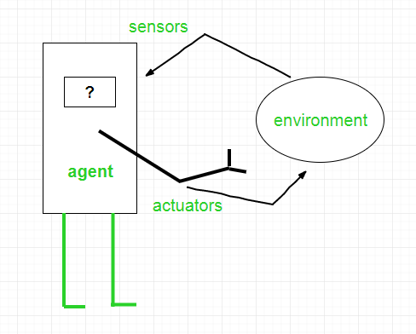
Agents in AI
An agent is anything that can be viewed as :
perceiving its environment through sensors and
acting upon that environment through actuators

Slide 35
Types of Agents
Agents can be grouped into different classes based on their degree of perceived intelligence and capability :
Simple Reflex Agents
Model-Based Reflex Agents
Goal-Based Agents
Utility-Based Agents
Learning Agent

Slide 36
Simple reflex agents
Simple reflex agents ignore the rest of the percept history and act only on the basis of the current percept.
The agent function is based on the condition-action rule. A condition-action rule is a rule that maps a state i.e, condition to an action. If the condition is true, then the action is taken, else not.
This agent function only succeeds when the environment is fully observable.

Slide 37
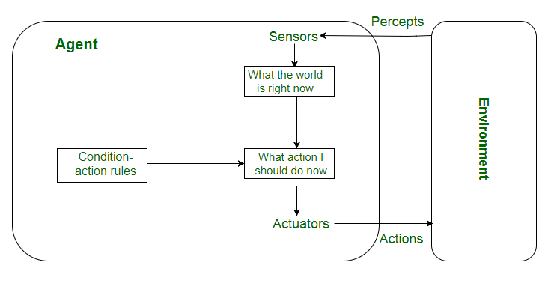
Simple reflex agents

Slide 38
Model-based reflex agents
It works by finding a rule whose condition matches the current situation. A model-based agent can handle partially observable environments by the use of a model about the world. The agent has to keep track of the internal state which is adjusted by each percept and that depends on the percept history. The current state is stored inside the agent which maintains some kind of structure describing the part of the world which cannot be seen.
Updating the state requires information about :
how the world evolves independently from the agent, and
how the agent’s actions affect the world.

Slide 39
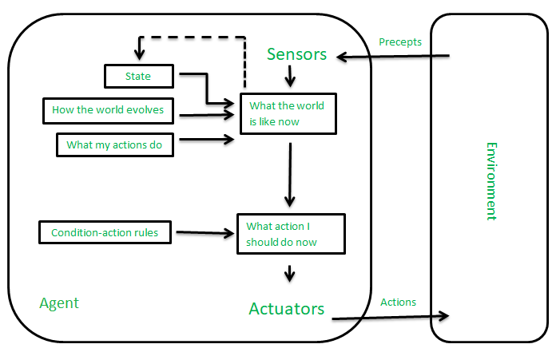
Model-based reflex agents

Slide 40
Goal-based agents
The knowledge of the current state environment is not always sufficient to decide for an agent to what to do.
The agent needs to know its goal which describes desirable situations.
They choose an action, so that they can achieve the goal.
These agents may have to consider a long sequence of possible actions before deciding whether the goal is achieved or not. Such considerations of different scenario are called searching and planning, which makes an agent proactive.

Slide 41
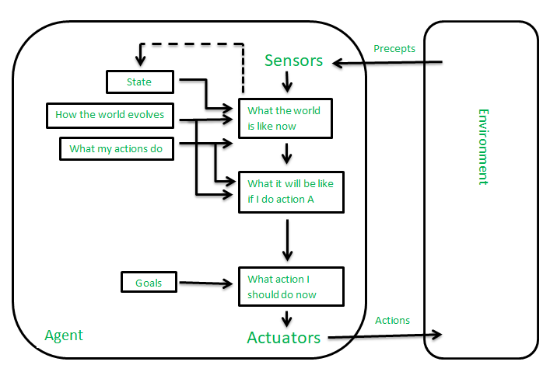
Goal-based agents

Slide 42
Utility-based agents
These agents are similar to the goal-based agent but provide an extra component of utility measurement which makes them different by providing a measure of success at a given state.
Utility-based agent act based not only goals but also the best way to achieve the goal.
The Utility-based agent is useful when there are multiple possible alternatives, and an agent has to choose in order to perform the best action.
The utility function maps each state to a real number to check how efficiently each action achieves the goals

Slide 43
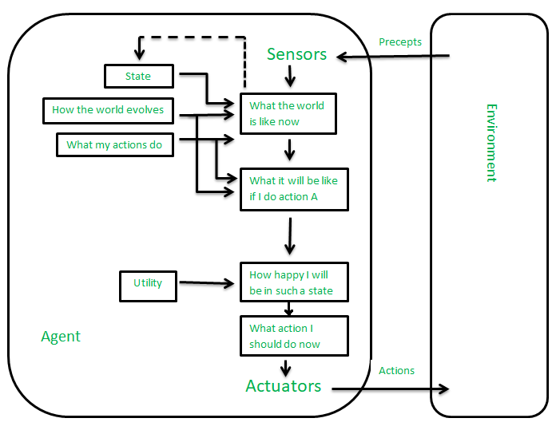
Utility-based agents

Slide 44
Learning Agents
A learning agent in AI is the type of agent which can learn from its past experiences, or it has learning capabilities. It starts to act with basic knowledge and then able to act and adapt automatically through learning.
A learning agent has mainly four conceptual components, which are:
Learning element: It is responsible for making improvements by learning from environment
Critic: Learning element takes feedback from critic which describes that how well the agent is doing with respect to a fixed performance standard.
Performance element: It is responsible for selecting external action
Problem generator: This component is responsible for suggesting actions that will lead to new and informative experiences.
Hence, learning agents are able to learn, analyze performance, and look for new ways to improve the performance.

Slide 45
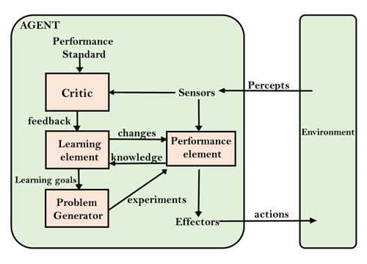
Learning Agents

Slide 47
Any Question?

